Slide 1
Professional Practice of Education Assistants
Best Practices

Slide 2
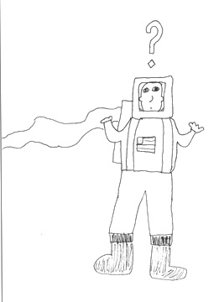
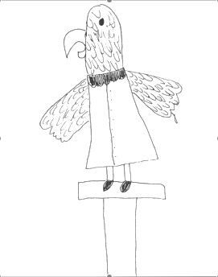

How to be a ParaPro
Space Cadet
  No sense of what students need, nor how to provide support. Inappropriately follows recommendations
The Parrot Para
  Simply repeats all teacher directions; doesn’t individualize or shift from auditory to visual supports

Slide 3
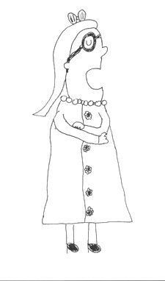
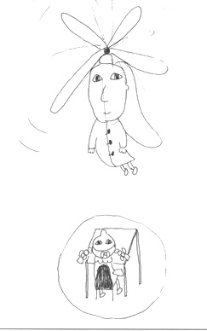
How to be a ParaPro
The Know-it-all
  Not willing to consider input from others, let alone learn from the student
The Helicopter
  Hovers & smothers; hinders rather than facilitates learning; creates learned helplessness and prompt dependency (uses intrusive verbal prompts)

Slide 4

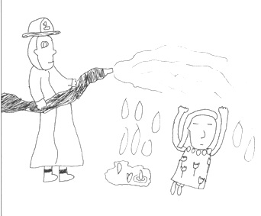
How to be a ParaPro
The Invisible
  Attends to matters outside the needs of students; fails to see cues that signal impending problems
The Fire Fighter
  Employs reinforcements that often maintain a behaviour or situation

Slide 5
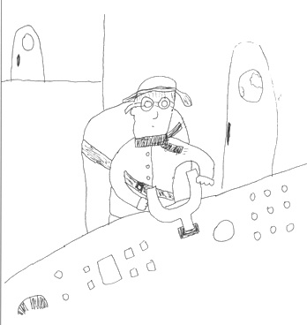
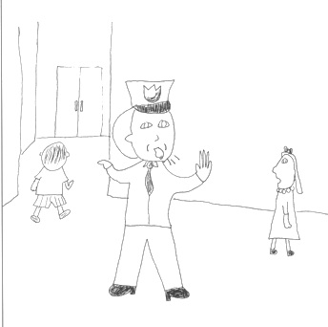
How to be a ParaPro
The Automatic Pilot
  Task-oriented not student oriented; uses highly intrusive supports
The Traffic Cop
  Directs rather than facilitates; often forgets to involve students

Slide 6
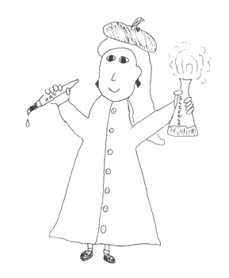
How to be a ParaPro
Knows students
Analyzes situations & makes sound judgments
Has a repertoire of strategies
Promotes self determination and independence
Facilitates participation
Willingness to learn

Slide 7

Who is the main driver?

